Slide 1
Effective Staff Committee Meetings
SURT October 2020

Slide 2
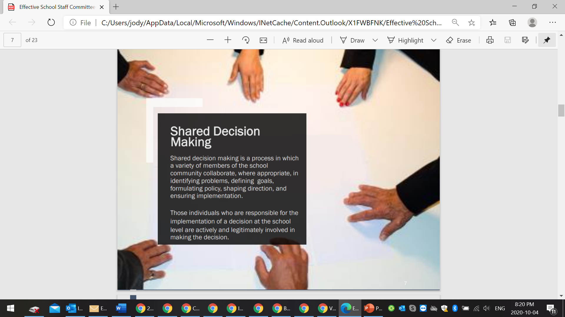

Slide 3
What is a Staff Committee?
Collective Agreement
Shall be established in each school
Does not limit duties and authority of Principal / Vice Principal (School Act, Labour Code, board policies)
Responsibilities
To represent the staff
To receive and make recommendations
To advise and assist administration in the solution of specific problems
To develop and maintain effective communication and consultation
To review school policies and procedures and develop recommendations for improvement

Slide 4
Function
The Committee shall have the right to provide advice to the Principal/Vice-Principal(s), and to consider the following matters in relation to the operation of the school:

Slide 5
Provide advice to the P/VP
Staffing and assignments of teachers in the school
Teaching assignments
Utilization of SSSWs
Consideration of upcoming postings
Organization of classes (class casting)
Planning for the next school year
Physical requirements for classes
Provision of learning materials
Student assessment and reporting

Slide 6
Provide advice to the P/VP
Assess teaching and learning conditions and recommend improvements
Placement and transfer of students
Staff-administration communication and relationship
School climate
Wider community or neighbourhood issues
Learning resources and availablility

Slide 7
Provide advice to the P/VP
School Curriculum Planning and Evaluation
School wide themes or assessment
Events involving the community
Evaluation / reporting formats and schedule
School calendar
Professional and Staff Development Activities
Working with Pro-D committees to suggest and plan content
Supporting teacher participation in inquiry projects

Slide 8
Provide advice to the P/VP
School Regulations, Policies and Routines
Assemblies
Attendance protocols
Parent teacher events
Discipline plans and procedures
Collection of money
Field trips
School-wide events
Communication with parents

Slide 9
Provide advice to the P/VP
School Timetable and Organization
Class sizes and fairness across the school
Gym or other shared spaces
Schedules, lunch time routines
Any other matter of concern to the members of the school staff

Slide 10
Staff Committee Committees
Interviewing Committee
Professional Development Committee
Timetable and Staffing Committee
Finance Committee.

Slide 11
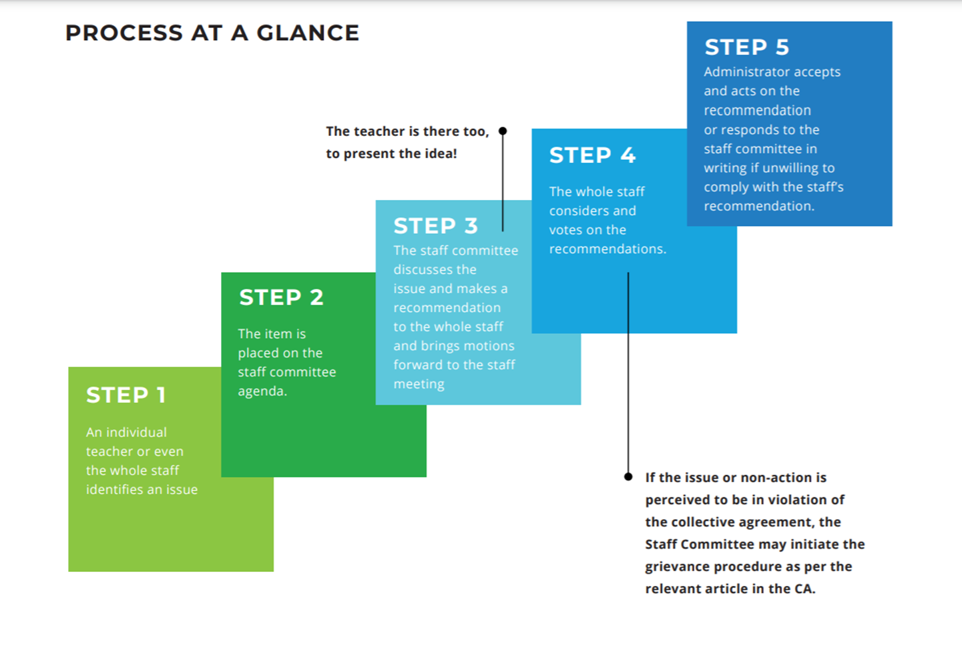
How can I make a change at my school?

Slide 12
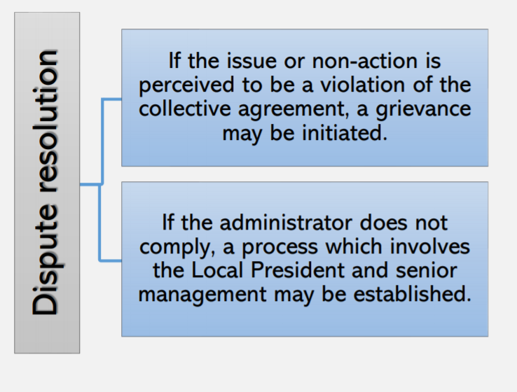

Slide 13
What if there is no staff committee at my school, or is not functioning well?
Each staff member has the right to establish or call a Staff Committee meeting
Remember that the Staff Committee is a part of your collective agreement and you cannot be denied that right
Speak to colleagues – make sure representative of different roles in the school
Talk to your Staff Rep about putting it on the agenda of the next VESTA meeting
Circulate dates of meetings in advance and post agenda in the staff room where anyone can add their items

Slide 14
Who should be on the Staff Committee?
All members of a school or a representative
Principal / Vice Principal
Entire staff or 20 employees selected by the staff representative of diversity of staff
VESTA Staff Rep
Chairperson is a teacher elected by teachers
Secretary is a teacher who takes minutes
Non-teaching staff should be welcomed to attend, but as this is a contractual meeting between teachers and administrators, they may not vote

Slide 15
What tips help things run?
Hold a VESTA meeting first to discuss if items ought to be discussed in private among teachers first
Plan to have staff committee meetings in advance of Principal staff meetings
Special meetings on urgent issues can also take place
Solicit agenda items from other staff members
Create agenda and circulate prior to the meeting – important that staff know what will be discussed
Share minutes with the whole staff

Slide 16
What do I need to know about chairing a meeting?
Determine your own style based on your school culture
Some formality helps to keep things focused
Chair will keep a speakers’ list and letting people speak in turn
Report or discussion can happen first, followed by a motion and debate, then a vote, or you can start with a motion
The most important thing is that everyone understands what they are voting on and that the outcome of the vote is clear

Slide 17
BCTF Members’ Guide
That the purposes of staff committees are:
a. to promote democratic decision-making in schools.
b. to ensure greater commitment to decisions.
c. to enhance professionalism and the quality of education.
Staff committees:
a. are based on principles of participatory democracy, professional practice and collegiality.
b. are consistent with the terms of local collective agreements and Federation policy.
c. provide an opportunity for every staff member to be directly involved in shaping the educational policies and practices of the schools.
d. provide teachers with the authority and autonomy to reflect on their practice, share and analyze this reflection with colleagues and apply the results of this analysis to the practical, day-to-day decision and policy making at the school level.
e. provide a forum for collegial problem-solving on matters of resource allocation, education policy and professional practice within the school

Slide 18
VESTA policy
That the Staff Committee at each school analyze the staffing requirements for the integration of special education students when it carries out its function of addressing the timetable and organization of the school.
That solutions consistent with the bargaining agreement recommended by the school team be presented to the Staff Committee for endorsation.
That the Senior Teacher position be for one (1) year and be rotated among those interested as determined by Staff Committee decision.
That the Staff Committee be fully involved in all aspects of the staffing and organization of the school.
That Staff Committees should oppose and not participate in the development of any school organization that entails a reduction in current staff or services.

Slide 19
VESTA policy
That VESTA continue to support school-based staff committee decisions on both content and timing of Professional Development/Staff Development Non-Instructional Days
That the usage of Curriculum Implementation Funds, Professional Development and Joint Conference funds be determined by the staff committee in each school upon the recommendation of the school PD Committee
That all teaching staff must be involved in the school organization and in particular with regard to the assignments of students to classes.
That the Staff Committee in every school be encouraged to establish a teacher liaison who would attend all PAC meetings and report the teachers’ concerns and issues to parents and who would report back to teachers on parents’ concerns and issues.
That Staff Committee will ensure that a process is established to plan collegially for school based staff development.

