Slide 1
Post and Fill
April 2025

Slide 2
Agenda
Welcome and Acknowledgment 9:00
New STP Timelines and Process
School Org Timelines
Break 10:15 – 10:30
Staffing impacts on School Org
Organizing your school
Lunch 12:15 – 1:15
CSCC / Jackson Arbitration / Best Efforts
Local Bargaining
Questions

Slide 3
Spring Transfer 2025 Timeline
Complete:
March 15
Deadline for vacate cards
March 31
Notification to return from leave
Deadline for applications for 1+ year leave
Application for parenthood leave
Courtesy notification to change FTE

Slide 4
Spring Transfer Timelines ct’d
Prior to June 1
Employees informed in writing of transfer due to surplus staffing
March 31 (NEW)
ERIP Notice Deadline
May 26-June 27 Spring Transfer Periods (NEW):
5 weekly rounds
3 days of posting (Mon-Wed), followed by 2 days of interviews (Thu-Fri), with job offers made by Friday evening
June 16
Placement of unassigned Category C employees begins
Notes:
Contact Greg if ERIP deadline is missed. VEAES will advocate.

Slide 5
Spring Transfer Timelines ct’d
June 27 onward
Interviews and offers for continuing positions
Temporary postings may be held for continuing placements
August 12-18
Summer Posting period
August 19 onward
Interviews and offers for continuing positions only
Temporary postings may be held for continuing placements
September 1 - 3
Posting Period 1

Slide 6
Vacate vs posting
Vacate (E.21.11-12) Card submitted to district means:
Your position is considered vacant for school organization
You are guaranteed not to be placed back into your previous school
You cannot post back into your previous assignment
Posting (E.21)
Any member has right to apply to any position of any FTE (unless you’ve already applied & accepted one for that year)
You do not need to give up your position in order to apply for other jobs
Notes:
- If posting successfully into a new job with a different FTE than your current one, that becomes your new continuing FTE (can be either more or less)
- If successful candidate in spring transfer of this year, you can’t post into another job until next year’s spring transfer

Slide 7
Surplus vs layoff
Surplus - more frequent (E.26) than layoff
Reflects slight decrease in enrolment or geographical movement within the district
No change to pay / benefits
Notice in May, apply for postings as “C” candidate
Continued entitlement to FTE but not at current worksite
If not successful in postings, HR will place
3 year protection from being surplused again (this year PLUS 2 years)
Layoff - less frequent, months of notice (C.22)
No longer an employee of the district
Onus on member to find work through posting

Slide 8
School Organization Meeting Timelines
Staff Meetings
VEAES Meeting
Staff Committee Meeting
Making Recommendations

Slide 9
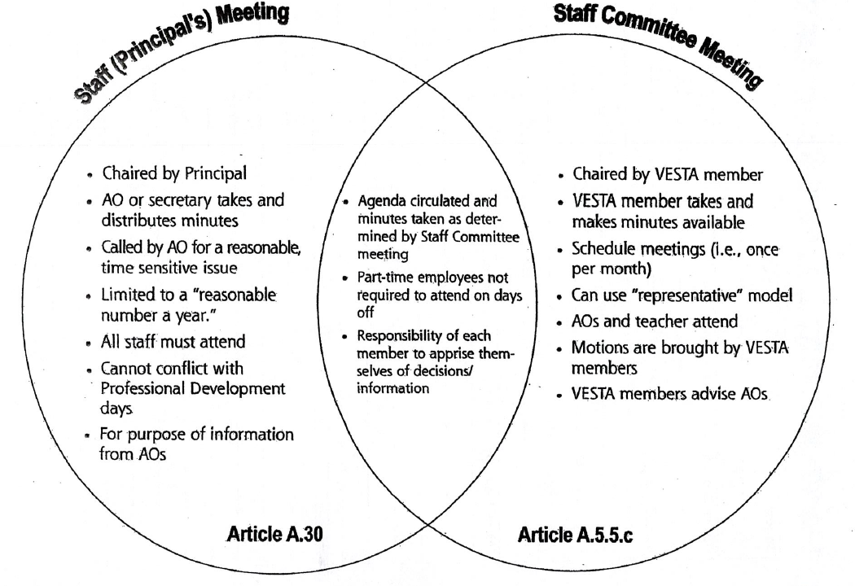
Staff Meeting vs. Staff Committee

Slide 10
Staff Committee Provisions
A.5.5.c.
“Staff Committee …shall operate without derogating from the duties and authority vested in the P/VP pursuant to School Act, School Act Regulations, Labour Relations, Code, subject to provisions of the CA, the policies of the Board”
Provide advice to P/VP and consider the following matters in relation to the operation of the school
Adequate physical requirements
Suitable instructional assignment
Adequate supply of learning materials
Time to plan, organize and work with individual students, colleagues and parents
Student evaluation
Assess the teaching and learning conditions and make recommendations for improvement
Study and make recommendations on school regulations and routines
Conduct studies on school philosophy
Notes:
Staff Meeting
In May, your principal will receive staffing information and should soon after make available all staffing information to the Staff Rep, including the category and grade levels of designated students.
The Staff Rep should receive a copy of the Staffing Entitlement form. If you do not receive a copy, please contact the VEAES office and we can follow up with Human Resources.
VEAES Meetings
After receiving the staffing information, call a VEAES meeting to discuss possible organizations
You may need more than one VEAES meeting to discuss, strategize, decide and complete your plans.
Please remember that while meeting together to discuss and decide on staffing recommendations for next year it is critical that teachers have solidarity and support for the recommendations. Our solidarity is critical to our success.
Note that teachers returning from maternity leave should be given the same or a similar assignment.
Please only make recommendations that are supported by all teachers and that are in compliance with collective agreement provisions. You may have many, just a few recommendations or none depending upon what your staff can agree to.
The school should be organized in accordance with class size and composition language. That includes best efforts and remedy.

Slide 11
Staff Committee Provisions
A.5.5.c.
Participate in planning and scheduling of professional and staff development activities
Contribute to school curricula planning and evaluation
Be involved with the timetabling and organization of the school
Consult and be involved in school staffing and to conduct studies of the utilization of staff, including auxiliary staff, and to make recommendations to AO
Explore any other matters of concern to the members of the school staff
In order to assist with the above, to establish any or all of the following committees
Interviewing Committee
Professional Development Committee
Timetable and Staffing Committee
Finance Committee
Notes:
Staff Meeting
In May, your principal will receive staffing information and should soon after make available all staffing information to the Staff Rep, including the category and grade levels of designated students.
The Staff Rep should receive a copy of the Staffing Entitlement form. If you do not receive a copy, please contact the VEAES office and we can follow up with Human Resources.
VEAES Meetings
After receiving the staffing information, call a VEAES meeting to discuss possible organizations
You may need more than one VEAES meeting to discuss, strategize, decide and complete your plans.
Please remember that while meeting together to discuss and decide on staffing recommendations for next year it is critical that teachers have solidarity and support for the recommendations. Our solidarity is critical to our success.
Note that teachers returning from maternity leave should be given the same or a similar assignment.
Please only make recommendations that are supported by all teachers and that are in compliance with collective agreement provisions. You may have many, just a few recommendations or none depending upon what your staff can agree to.
The school should be organized in accordance with class size and composition language. That includes best efforts and remedy.

Slide 12
Meeting Timelines: School Organization
Staff Meeting
Principals receive Staffing Allotment form HR in May.
Principals meet with VEAES Reps and Staff to share staffing numbers.
Call a VEAES meeting(s)
discuss methods of organizing
that are fair and equitable for all employees (i.e., seniority, rotation) and meet class size and composition language.
Discuss teacher preferences
Try to determine a way to distribute assignments, prep schedules and any timetabling that affects teachers’ scheduling.
Always respect professional autonomy.
Notes:
Staff Meeting
In May, your principal will receive staffing information and should soon after make available all staffing information to the Staff Rep, including the category and grade levels of designated students.
The Staff Rep should receive a copy of the Staffing Entitlement form. If you do not receive a copy, please contact the VEAES office and we can follow up with Human Resources.
VESTA Meetings
After receiving the staffing information, call a VEAES meeting to discuss possible organizations
You may need more than one VEAES meeting to discuss, strategize, decide and complete your plans.
Please remember that while meeting together to discuss and decide on staffing recommendations for next year it is critical that teachers have solidarity and support for the recommendations. Our solidarity is critical to our success.
Note that teachers returning from maternity leave should be given the same or a similar assignment.
Please only make recommendations that are supported by all teachers and that are in compliance with collective agreement provisions. You may have many, just a few recommendations or none depending upon what your staff can agree to.
The school should be organized in accordance with class size and composition language. That includes best efforts and remedy.

Slide 13
Recommendations
Some possible outcomes of VEAES meetings
Develop new
organization
Nothing
General advice:
organize in accordance with class size/composition language
organize with straight grades
Put names on an organization
Staff reps can submit VEAES recommendations, in writing, through Staff Committee.

Slide 14
Preparing for organization
Gathering information on staffing
Consider staffing in the context of your school community
Staff Committee language

Slide 15
Posting Timeline LOU
Effective April 1 2025 to March 31 2026 only
Meant to address issues such as:
Temporary positions lagging behind continuing
Lack of timelines around offering positions
Slow interviews
High number of unfilled vacancies before summer break/following school year begins
Notes:
Due to the compressed posting timeline, it is important that applicants be extra attentive to phone and email communication from P/VP who will be contacting them to arrange interviews and offer jobs.
-Introduce tracking log

Slide 16
Values to consider
Seniority
Workload
Fairness
Solidarity
Complexity of students
Beginning teachers
Desirability of Postings
Notes:
Class castin
Equitable class compositions
Retention of newer teachers

Slide 17
School Organization: A Closer Look
Who is Included?
Consolidation of Time
Surplus
School Based/District Assignments
Procedures for Increasing and Decreasing Time
Staffing Entitlement
Sample Organization (SOA)

Slide 18
Overarching Concepts
Employment Standards Act Protections
Maternity Leave
Medical Leave
Posting leaves of one year or longer (E.21)
School-based and district staffing (E.23)
Class Size and Composition (Restored Language)
Transfer due to surplus staffing (E.26)
Filling of District Positions (E.27)
Professional Autonomy (F.20)
Staff Committee (A.5.5.c)

Slide 19
Factors for FTE - Organization
Increase and decrease in FTE*
Returns from leave (partial and full)
Surplusing
Dual track schools / staffing
Consolidations
*No longer necessary to submit request to change FTE by March 31. District ultimately has the power to approve or deny

Slide 20
Procedures for Increasing Time
Teachers who decreased for less than one year automatically increase back – their decrease should have been posted temporarily. (As per C.20.3.a and C.20.3.b)
Requests to increase will be considered if the time is available at the school site and if the increase in time will not cause a surplus.
Note: If there are layoffs, no increases in time can be granted using this mechanism. (Article C.20.3.c)
If a teacher wishes to increase their time, and there is not time available at their school they can continue to participate in the post and fill process and/or submit a vacate card up to 7 days after the staffing is provided

Slide 21
Procedures for Decreasing Time
C.20.3.a. An employee with a previous or current continuing full-time appointment to the staff of the District may, without prejudice to that appointment, request a part-time assignment, specifying the fraction of time requested, and the length of time, not to exceed one (1) year, for which the part-time assignment is requested. The Board shall not unreasonably refuse such a request.
A request to reduce time may be made at any time during the year and shall not be unreasonably denied. However, the ability to increase FTE will be in accordance with the process for increasing time.
Notes:
-this year’s calendar results in both Mondays and Fridays in less than 0.2
-for part time teachers who wish to decrease their FTE so they do not owe additional time to their school, they will be able to fill in the Request for Increase/Change in Teaching Time
This is considered a permanent decrease
80/20 case by case
-this is an option you should consider carefully as it affects your salary and pension
-arrangements to make up the time should be made at the beginning of the school year

Slide 22
Consolidation of Time
Upon the request of the member to the Union, there may be a possibility to consolidate their entire FTE at one worksite. Conditions for agreement include:
Time is available at the worksite.
All other increases of time have been granted at that site, including increases for members who have not been full time in the past.
The Board and the Union agree to a without prejudice agreement.
You should contact the VEAES office to make this request.

Slide 23
School Organization: Who to include?
Who to organize into your school organization
Teachers who have posted into continuing positions in your school
Teachers who are on leaves for less than one year
Teachers on Maternity Leave with continuing contracts
Teachers on Parental Leave returning in less than one year
Teachers who have reduced their time not exceeding one year
Notes:
- Generally we don’t contact members who are on leaves, but for the purpose of School Org, it is advisable that the staff rep or point person let them know to avoid future issues

Slide 24
School Organization: Who to exclude?
Who is excluded from your school organization?
TTOCs covering extended leaves
Teachers on temporary contracts who have converted to continuing status
Teachers who are on Personal Leave for one year or longer
Teachers on Medical Leave for more than one year*
Any teachers who submitted a commit to transfer card (vacate card) prior to March 15
*They have a right to return to the site where they took leave from, which may trigger a surplus.

Slide 25
E.26 Transfer Because of Surplus Staffing
Who is determined surplus to the site?
Extra staffing beyond allocation beginning with the person(s) with least seniority.
A teacher working at multiple sites who is declared surplus at one site will no longer have a position at any site. They will be considered surplus for their entire assignment.
A more senior teacher could voluntarily accept being declared surplus and that would affect (or negate) the impact of surplus staffing on the least senior teacher(s) at the site.
Note: A teacher who is declared surplus participates in Spring Transfer as a Category “C”
Notes:
Surplussed employees who do not post successfully into a job will be included in the placement pool (July). Just because you are placed doesn’t mean you can’t post into a position.

Slide 26
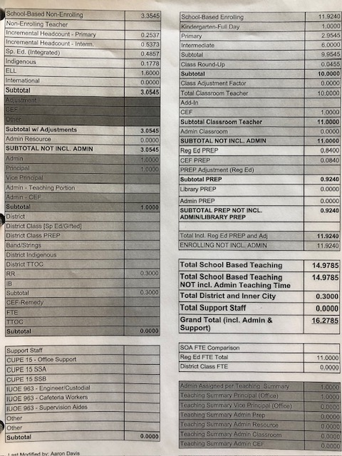
Staffing Entitlement
Notes:
(If Unused Remedy LOU is signed off) New line for the 2025-2026 school year to show the unused remedy owed to each school. This is converted into FTE and should be used toward RT time.
- There are often many ways to organize enrolling FTE: multi-age/split class. Organization should be in compliance with restored language provisions.
- “Class Round-up” is sometimes given to schools that have workable FTE for class organization.
- CEF = Classroom Enhancement Fund. Like CEF enrolling classes, CEF prep is separated out. The CEF is the funding that is generated from the class size and composition language.
NOTE: Dual track schools will receive a separate staffing entitlement for French Immersion. Surplusing will still happen by seniority. (Teachers will need to be fluent in French.)

Slide 27
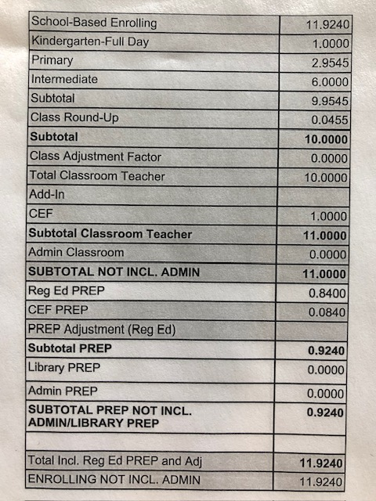
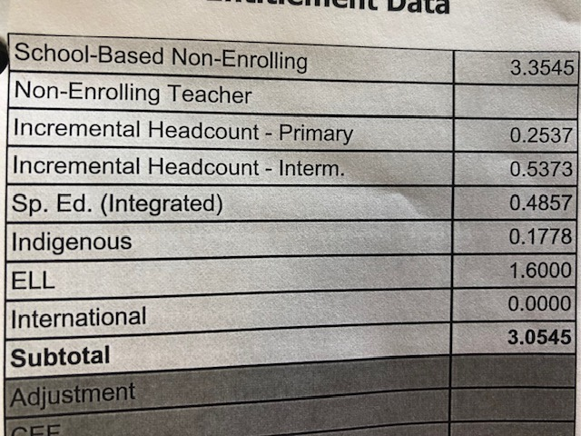
Staffing Entitlement
Notes:
- In small schools, and schools with Principals, many Vice-Principals are only part time. The rest of their FTE comes from enrolling and non-enrolling staffing.
VEAES’s position has historically been that VPs not assume incremental positions due to their many absences and lack of EOC coverage from day one.
- District FTE is not posted at the school site.
This includes positions such as Area Counsellors, SLPs, etc. Article E.27 governs this process.
Some district classes are posted at the school site as per Article E.23. Teachers in these positions have site-based rights and can be re-organized into other positions at their site.
Other district programs found in E.23 do not have site-based rights.
- Now separates out multiple categories that separate staffing. Does not show LAC or Teacher-Librarian.
Please remember that VEAES members do not make recommendations to reduce another member’s assignment.

Slide 28
Unused Remedy
Tentative LOU to settle how the outstanding 2022-23, 2023-24 remedy time will be used
Notes:
Motion passed at March 11 GM to pursue the draft LOU with the employer.
If signed, it will allow unused remedy to be converted into FTE for each school and to be included in SOAs as a separate line item. The FTE must be used as resource time, and can be absorbed internally by PT teachers (the new FTE will become their continuing FTE contract) and/or incorporated as part of a posting.
Over the past few years, VEAES membership has passed motions for unused remedy to be decoupled from individual members and for remedy in generally to be used towards staffing. This LOU follows these policies.
LOU not perfect, but it’s the closest we’ve gotten in 2 years to get the employer to agree to put remedy towards staffing.
Hold a VEAES meeting to inform members. Important that everyone understands.

Slide 29
Surplus: Example 1
Example 1 (no one to surplus)
18.6 FTE staffing to school with 18.0 FTE teachers to organize
18.6 FTE
–18.0 FTE
0.6 FTE which is used to fulfill any request to increase time at the school or to generate a posting

Slide 30
Surplus: Example 2
Example 2 (surplus situation)
17.4 FTE allocated to school with 18.0 FTE teachers to organize
17.4 FTE
–18.0 FTE
(0.6) FTE means there is a surplus amount of teachers at the school

Slide 31
Surplus: Example 2
17.4 FTE
–18.0 FTE
(0.6) FTE
Three Scenarios: | Results:
1. Teacher A 1.0 FTE (next lowest) Teacher B 0.8 FTE (lowest seniority) | Teacher B is declared surplus with 0.2 FTE available to be used to fulfill a request to increase time or generate a posting
2. Teacher A 1.0 FTE (next lowest) Teacher B 0.2 FTE (next lowest) Teacher C 0.2 FTE (lowest seniority) | Teacher A, B and C are declared surplus with 0.8 FTE available to be used to fulfill a request to increase time or generate a posting
3. Teacher A 1.0 FTE (next lowest) Teacher B 0.6 FTE (lowest seniority) | Only teacher B is declared surplus and no extra staffing allocation exists
Notes:
Requests to increase time cannot create a surplus, but if there is additional time remaining from a surplus, they can be used to fulfill people’s increases in time requests

Slide 32
Example Recommendations
That where possible, the school be organized with straight grade classes
No grade 3/4 split classes
That there be no reduction in T-Lib/ESL/LAC time
That teachers be placed in preferred assignments by seniority
These recommendations should come to Staff Committee in the form of a motion.
Useful stems are:
“THAT VEAES members recommend . . .”
“THAT the following organization be adopted . . .”
“THAT the following principals guide the organization of the school . . .”
As per Article A.5.5.c.iii(d), the principal needs to give reasons if they disagree with the motion and this will be recorded in the minutes.
Notes:
-the administrator has the final say in the organization
-they do not need to follow seniority in placing teachers
- The more organized and engaged the staff is in the school org process, the more likely admin will follow our recommendations

Slide 33
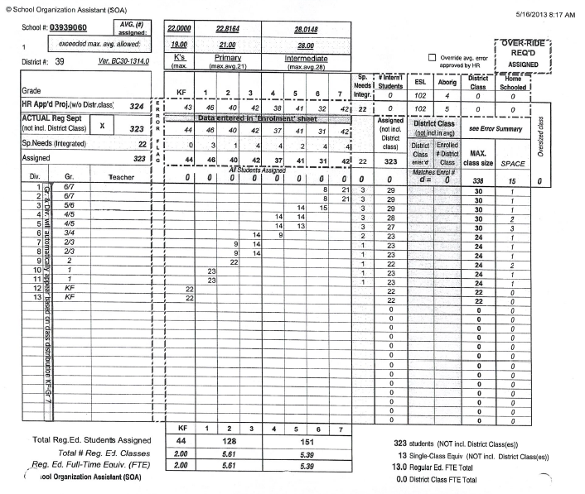
Sample School Organization

Slide 34
Prep Time
2022-2025 provincial negotiations resulted in 10 minutes of additional prep time for Elementary teachers (total 120 min per week, based on 1.0 FTE)
VSB position is that the decisions on how prep is provided will belong at the school level – no district directive
Prep must be provided in meaningful blocks (min 20 min), may impact timetable
Library / curricular subject areas sensitivity
Notes:
-the administrator has the final say in the organization
-they do not need to follow seniority in placing teachers
-some school staff recommends that prep time be decided upon collaboratively (i.e. sign-up, trade blocks with each other). This can work if there is true consensus. Absent consensus, it’s better to leave prep assignment to admin. This must be balanced with consultation with the prep teacher as this impacts their schedule.

Slide 35
School-Based/District Assignments
School Based/District Program assignments will be posted by the individual schools
District assignments do not “belong” to the school for purpose of internal re-organization. Teachers move if program moves
All teachers have the right to access post and fill process

Slide 36
School Based/District Assignments
4. All district programs are defined as school based except for the following:
Provincial Resource Programs (Set BC)
G.F. Strong Centre School Programs
B.C. Children’s Hospital School Programs
Sunny Hill School Program
Peak House
Canuck Place
SET BC
Vancouver Learning Network (VLN)
Home Learners Program
Low Incidence Programs (Life Skills / CORE)
SELC, EXSEL
District Literacy Enhancement Teachers
*Excerpted only elementary programs for this slide
Notes:
There may be others that have been added since the printing of this collective agreement. Contact VEAES.

Slide 37
Overview: Changes in the Post and Fill Language E.21
Since 2019
Notes:
Melding pfft

Slide 38
Article E.21
Category Bands
Vacate Process
Job Shares
Interview Committees
Internal Postings / Increases
Maternity/Parental Leave (NEW)
Notes:
Activate Interview Committees again to track postings/interviews/job offers

Slide 39
Article E.21 – Category Bands
E.21.4. Other than for Clause 3.b. above, applicants will be interviewed and offered positions in the following order:
Category A Principals / Vice Principals returning to teaching, those returning from VTF, BCTF and CTF leave, subject to the provisions of Article G.21.30.f
Category C Employees with continuing contracts with or without an assignment
Category D Employees on the recall list.
Category E Employees on temporary contracts who are recommended for retention in the District by their Principal/Vice Principal/ Supervisor.
Category F Employees hired by the Board.
CATEGORY B REMOVED
Notes:
The category band “B” has been eliminated. This means that teachers who:
Are a board-initiated transfer
Are committed to a transfer (have put in a vacate card)
are surplus to a school
are returning from leave or
are part time employees seeking full time assignment
are now all in category band “C”: “Employees with continuing contracts with or without an assignment.”
in practical terms, this means that all applicants with continuing contracts will be in the same category “C.”
If you vacate your position, you will no longer have priority for job offers, but you are guaranteed not to return to that school
the vacate option is still there for teachers who want to ensure that they do not remain at their current school. If you put in a vacate card, you give up your position in advance of the spring transfer process, and cannot apply for positions at your current school.
The same date applies
Category A,D,E and F remain the same

Slide 40
Article E.21 Vacate Process
E.21.11 An employee who commits to a transfer shall inform Employee Services the Human Resources Division in writing by March 15 of each school year. Their position will then be considered vacant for the purpose of posting.
E.21.12 An employee committed to a transfer as referred to in Article E.21.4 shall not be permitted, in the same school year, to apply back to their previous worksite.
E.21.16 After June 15 of each school year, all placements will be made and individuals informed of such by the Employee Services. For individuals who do not have an assignment, the provisions of Clause 4 above shall apply.
Notes:
Committing to a transfer E.21.11, 12 and 16
If you are planning on applying for positions in the STP and do not want to remain at your current school the following year, you can put in a “commit to transfer card” by March 15th. This will ensure that you will have a position at another school and not return to your current school in the fall. If you cannot find a position during the STP, the VSB will place you in a position.
The previous language stated that an employee committed to a transfer could not apply back to their former position or to essentially the same position as their former position at their previous worksite.
Collective agreements are on a go forward basis. The salary is retroactive, but other changes, like seniority are on a go forward basis only.

Slide 41
Article E.21- Job Shares
E.21.8. Employees who wish to transfer as a job-share team for a 1.0 FTE position shall be permitted to apply and transfer as a team on a 50/50 or 40/60 basis with each employee working full days. The Board will review a job-share by March 15 to determine continuation for the following school year.
Notes:
Job Share E.21.8
Teachers can now apply for positions as a job share team, even if they are not currently in a job share. Teachers can split the FTE 50/50 or 40/60.
Teachers can still apply for a temporary decrease in time for less than one year as per article C.20.3.a
Teachers can apply for a part time position in the post and fill process
Each employee must work full days and the job share will be reviewed by march 15th for the following year
-working full days was always the case, this language reflects the practice
80/20 split
Transferring only not decreasing

Slide 42
Article E.21- Interview Committees
E.21.13. Interviews will be conducted by the administrator(s).
E.21.14. Offers made will be accepted or rejected within twenty-four (24) hours. An employee who has accepted a position shall not be eligible to participate in this process until the subsequent school year without the agreement of the Associate Superintendent – Employee Services or designate.
E.21.15. The Board will endeavour to inform all applicants who were interviewed within one (1) working day of the position having been filled. All applicants shall be so informed within two (2) working days. A Principal / Vice Principal shall, upon request, provide verbal reasons for their decision to any unsuccessful applicants.
Notes:
Most locals do not have teachers sitting on interview committees
Teachers evaluating their colleagues is not in line with the of the code of ethics and can impact grievance resolutions negatively
However, participating in the creation of postings and monitoring the shortlisting and interview process is a way to gain transparency and uphold accountability.
Staff Reps can still be available to share information about a school with applicants outside of the interview process
Union receives a Successful Candidate Form from the Board
Indicates who applied, their priority group, who was interviewed, who was offered the position and whether they accepted or declined
Should there be an issue with who was offered a position, we can use these forms to investigate
Encourage teachers to contact the VESTA office if they feel that the interview process was inappropriate or that the most senior candidate was not offered the position
Candidates can ask administrators where they rank among the applicants in order of seniority
You have 24 hours to accept or reject the offer. If you are interviewed and offered the job on a Friday, you have until the following Monday to respond.
The applicants who were interviewed should be informed within one working day of the position being filled.

Slide 43
Internal postings / increases
E.21.2 When the Board becomes aware that a position will be vacant for longer than three (3) consecutive months in a school year it shall immediately post the position internally for seven (7) calendar days. The Board may repost positions internally. Hard-to-fill positions may initially be posted internally and externally. Each posting shall describe the term, general nature and location of the assignment(s) and shall include the process and deadline for application.
E.21.11. An employee who has been notified by the site-based administration that they are unable to increase their FTE at their worksite can commit to a transfer by informing Employee Services in writing one week (seven [7] calendar days) after staffing allotments have been determined for each site.

Slide 44
Maternity/Parental Leave
New language bargained in 2025 round of local bargaining:
A teacher on a Maternity/Parental Leave (up to 18 months) will not be considered to have vacated their worksite and will be able to return to their worksite. The teacher’s position will be posted as a temporary contract.
Notes:
No surplussing would result from an 18-month mat/parental leave.
The job would only be posted as temporary contracts or entered into the SFE system if any portion is less than 3 months in length.
If the same assignment and/or contract spans over 2 school years as a result of an 18-month mat leave, C.20.2.b applies:
iii. An employee whose on-call assignment ends on the last day of a given school year does not automatically have the right to be given the same assignment in the following school year.
iv. In circumstances where the same teacher teaching on call who ended the on call assignment or term position described in Article C.20.2.b.iii above also receives the assignment in the next school year, the following shall apply: the teacher teaching on call, pursuant to Article C.20.2.b.ii of the Collective Agreement, will be awarded a temporary contract in the next school year after the employee has been in the assignment for more than three (3) months, calculated from the commencement of the previous year’s assignment.

Slide 45
Staff Committee Again!
We can be involved in every aspect of the post and fill process at the school, except for sitting in during interviews!
School organization
Timelines
Co-writing postings
Shortlisting
VEAES receives all shortlisting and successful candidate forms – please be active in the process!

Slide 46
Creating Inviting Postings
Remember: you’re writing the posting so your colleagues can make good decisions about where to apply!
School Profile
What is the community like?
Are parents active?
Is there a seismic upgrading / swing space ahead?
Are there any school programs that teachers might like to know?

Slide 47
Creating Inviting Postings 2
Position Details
Be as general as possible, as things can change (early primary, late intermediate, resource team)
Respect professional autonomy
No reference to required practice, pedagogy, field trips, extracurricular, etc.
Include job shares if applicable
Just because your school does things a certain way, doesn’t mean all new applicants will

Slide 48
Class Size and Composition
Class Size Limits
Class Composition
Jackson Arbitration
Best Efforts

Slide 49
Class Size Limits
Grade Level/Class | Class Size Maximum | Best Effort Floor***
Kindergarten | 20 | 15
K–1 | N/A | N/A
Grades 1–3 | 22 | 17
Grades 1-3 (split class) | 22 | 17
Grades 1-3 (multi-age) | 22 | 17
Grade ¾ (more 3s) | 22 | 17
Grade ¾ (more 4s) | 24 | 19
Grade 3/4/5 (more 3s) | 22 | 17
Grade 3/4/5 (more 4/5s) | 24 | 19
Grades 4–7 (Intermediate) | 30 | 24
Grades 4–7 (split) | 28 | 22
Special Education | 15
Flex Factor** (Article 9.B.14) | +2
*Class sizes maximums shall be reduced by 1 student for one or two students with special needs and by a further 1 student, if in very exceptional circumstances, a third student with special needs is added.
**Class size maximums can be exceeded by up to 2 (flex factor) after school has been in session for 20 teaching days due to an influx of pupils new to the school (however, composition ratios still prevail)
***The Board is not obligated to add additional divisions to meet class size and composition language if class sizes decrease below the Best Effort Floor
Notes:
-we’ll go through the class size and composition
Concept of “click down”

Slide 50
Class Composition
Maximums:
Maximum 2 students per class with a Ministry Special Needs designation
Under very exceptional circumstances, there may be a 3rd student with a designation*
Combinations of Ministry designations:
1 severe and 1 less severe category designation
2 less severe category designations
Notes:
We will be talking about very exceptional circumstances in the section on best efforts
Where class composition maximus are exceeded, that’s where remedy kicks in
Remedy for the third student with a designation is still under the grievance process and yet to be determined
There will be remedy on 4 or more special needs students

Slide 51
Class Comp: Our restored language
Combinations of Ministry designations (1995/present):
1 severe and 1 less severe category designation
2 less severe category designations
Severe (A, C, G, and H)
A – Physically Dependent/Multiple Needs
B – Deaf and Blind
C – Moderate to Profound Intellectual Disabilities
OG – Autism Spectrum Disorder (some of the current Gs)
H – Intensive Behaviour/Mental Illness
Less Severe (B, D, E, F, K and Q)
D – Physical Disability or Chronic Health Impairment
E – Visual Impairment
F – Deaf or Hard of Hearing
J – Severe Learning Disabilities (some of the current Qs)
K – Mild Intellectual Disabilities
Q – Learning Disabilities (excluding Js)
Who is not included? (for class composition numbers)
B – Deaf and Blind
G – ASD (not OG)
P – Gifted
Q – Learning Disabilities (except J)
R – Moderate Behaviour Support
Notes:
-if your organization has two students in a class in the severe category, remedy will be paid
-the Gs and Qs who count towards class composition will be outlined later in the Jackson arbitration

Slide 52
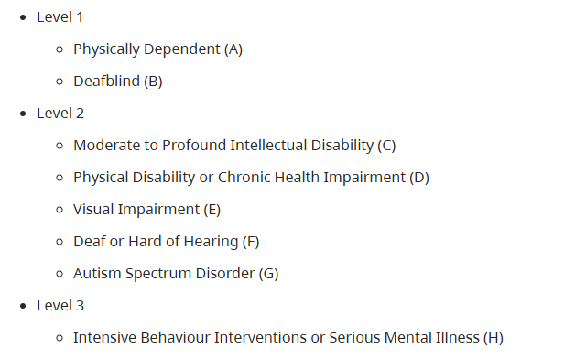
Supplemental Funding
$50,730
$24,070
$12,160
Notes:
Funding is not allocated directly to the students. It is used by the district to provide all manner of inclusion initiatives, district staffing, inclusion support, accessibility matters, support workers, itinerant staffing, potentially infrastructure…

Slide 53
Jackson Arbitration
Arose from disputes regarding application of restored language to current Ministry categories
Many local agreements have no CSCC language
Applies to those of us who use Ministry categories in our collective agreements
Focused on category definitions and which categories “count” towards CSCC language
Does not impact supplemental funding

Slide 54
Jackson Arbitration
Some Gs and Qs are included in class size and composition language, and some are not, based on the Jackson Arbitration which states that the restored provisions only apply to students who would have been included in the 1995 Ministry Manual.
Creation of OG and G categories
Redefining category Q
Impacting all CA language referring to Ministry categories (ours)

Slide 55
Why this is so confusing
Collective Agreement language does not correspond with Ministry categories, which have changed over the years.
Low Incidence: K, P, Q,R
High Incidence: A, B, C, D, E, F, G, H

Slide 56
Why this is so confusing
Collective Agreement language does not reflect Ministry categories “severe / less severe” – “high / low frequency”
Some designations receive ministry funding and some “count” towards class composition & remedy, and some are both, but they’re not necessarily the same.
i.e. all G students receive ministry funding, only OG students “count” for CSCC
i.e. some Q students might count for composition maximums as “less severe” but no Q students receive ministry funding
Notes:
-the team at learning services determines which fall under the parameters described in the Jackson arbitration
-the information of which G and Qs count is used for organizing classes under our class size and composition language
- Some G students, when delisted, were not considered for other designations and we’ve grieved it, the settlement will review those students who became G students that do not count towards CSCC to see if they qualify for another designation

Slide 57
Jackson Arbitration
Your administrator should give you a list of which students with designations are counted towards class size and composition, and which are not
This information is also available in MyEd
The definitions of “included” G and Q designations only apply to the collective agreement language for class size and composition and for remedy calculations
Notes:
-the team at learning services determines which fall under the parameters described in the Jackson arbitration
-the information of which G (and Qs that are Js) count is used for organizing classes under our class size and composition language
Some G students, when delisted, were not considered for other designations and we’ve grieved it, the settlement will review those students who became G students that do not count towards CSCC to see if they qualify for another designation
History of J:
1995 Ministry Manual made some changes concerning special needs categories. Around this time, Severe Learning Disabilities became category J.
2002 the Manual was further revised. J was replaced with Q Learning Disabilities
2019 Arbitrator Jackson was asked to determine category definitions, and which categories count. Jackson ruled that the 1995 definition of “severe learning disabled” (i.e. “J”) would be included in today’s category “Q”;

Slide 58
Non-enrolling District Ratios
Position | District Ratio
Teacher Librarian | 1:702 students
Counsellors | 1:535 students
Learning Assistance | 1:504 students
Special Ed Resource | 1:232 students
ESL / ELL | 1:64.7 students
These are minimum district averages and include elementary and secondary
Teacher Psychologists and Speech and Language Pathologists do not have district ratios
Prep time provided by TL’s can be included in the ratios
Resource provided by VPs should not be included in the ratios
The employer can combine non-enrolling teacher categories for posting positions
Notes:
TL Prep time: we filed a grievance on this but BCTF legal determined we did not have a case based on an arbitration decision from Surrey
-there is a previous agreement in 1999 that TL prep time can be used as part of the ratios

Slide 59
Best Efforts

Slide 60
Use of space
The parties recognize that not every available space within a school can reasonably be taken from other uses and adapted for additional classrooms
Re-examination of spaces on a school by school basis whether additional portables can be utilized or any additional spaces can be repurposed
Prep spaces (music rooms, computer labs, etc.)
Daycare, preschool, out of school care spaces
Rooms used for additional support for students (sensory rooms, counselling rooms, etc.)

Slide 61
How Remedy is Calculated
Value = (180 minutes) x (% of FTE) x (S1 + S2)
S1 = Highest # of students enrolled that month minus max class size limit
S2 = # of students in excess of class composition limit for that month
(Example) Gr. 5 class with 30 students and 5 IEPs
V = 180 x 1.0 x (2 + 2)
V = 720 minutes per month or 12 hours

Slide 62
How Remedy is Calculated (ct’d)
$ = (V in hours / student instructional hours) x FTE cost
Dollar value rounded to the nearest $
FTE cost is based on the provincial average salary plus 25% for benefits.

Slide 63
Next Steps
Hold a VEAES meeting
2. Share with colleagues:
Local Bargaining package
Updated Post and Fill info
3. Consider recommendations to bring to a Staff Committee meeting
4. Organize interview committees

Slide 64
Questions?

Slide 65
Thank You!
karine@veaes.ca
marjorie@veaes.ca
greg@veaes.ca
vanessa@veaes.ca
xander@veaes.ca
eric@veaes.ca

