Slide 1







New
Teachers

Slide 2
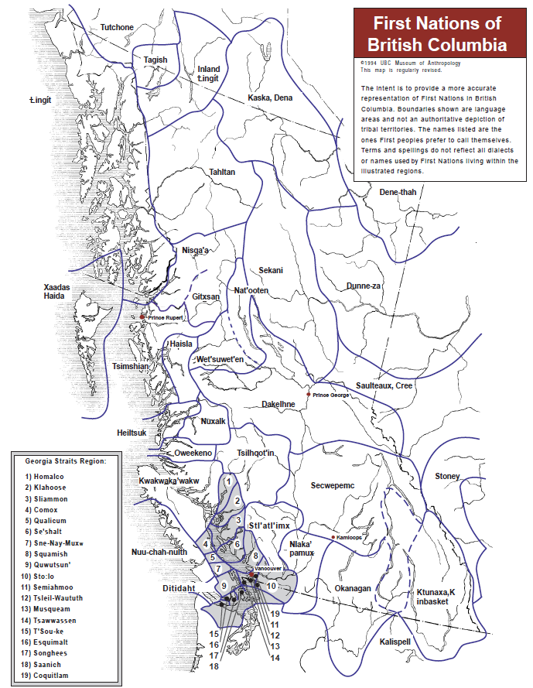
Acknowledgment
of
Traditional Territory

Slide 3

Objectives
to introduce new members to the local union and BCTF
to introduce new members to collective agreements and highlight sections most relevant to them
to educate new members about their health & safety rights
to explore the responsibilities and challenges of maintaining positive professional relationships
to build awareness about professional issues
to promote the work of the union and your place within it.

Slide 4


Public Education System
T-chart
Employer | Union
Ministry of Education BCPSEA | BCTF
Board of Education Administration | Local Teachers’ Association
Collective agreement
‹#›
‹#›

Slide 5

History of the

Slide 6

History Hunt Instructions
Fill out the History Hunt Chart using the information from historical highlights of the BCTF.

Slide 7
Professional
Relationships

Slide 8

Code of Ethics
Scenario: You are a beginning teacher and several
of your students are receiving in-class support from a very experienced resource teacher. You overhear this teacher complaining about your inexperience and inability to deal with the children in your classroom.
What are the issues here?
How would you work through this situation?
Who would you talk to about this situation?
Where would you turn for help with this situation?

Slide 9

Boundaries
Scenario: One of your colleagues has taken a student under her wing; buying her food, clothing, and ensuring she has shelter. The teacher has offered to take the student to church with her on Sundays.
What are the issues here?
How would you handle this situation?
Would you talk to someone
about this situation? If so who?
Where would you turn for help
with this situation?

Slide 10

Working with Parents
Scenario: A parent comes to speak with you about the grade/comment their child received. They are adamant that their child deserves a higher mark/more positive comment and that you should change it.
What are the issues here?
How would you handle this situation?
Would you talk to someone about this situation? If so, who?
Where would you turn for help with this situation?

Slide 11
Rights and
Responsibilities

Slide 12

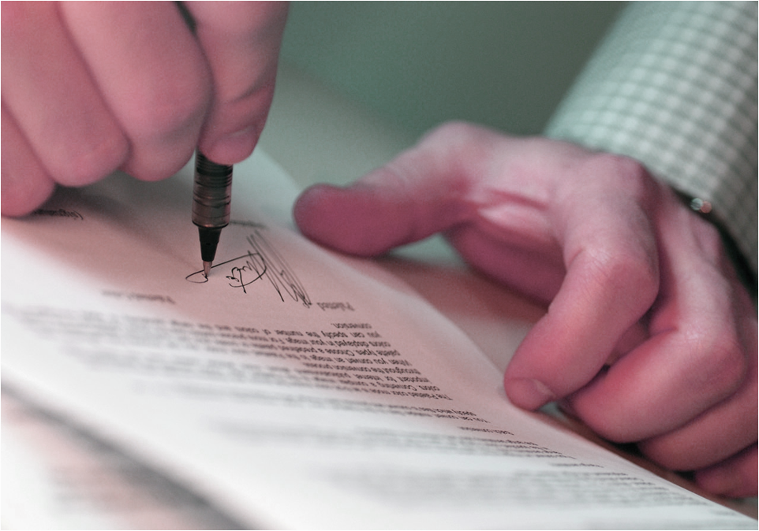
Collective Agreement

Slide 13

Teacher Evaluation
Worries? Questions?

Slide 14
Local Issues and Opportunities

Slide 15

Occupational Health and Safety
In your table groups discuss these scenarios…
What would you do?

Slide 16
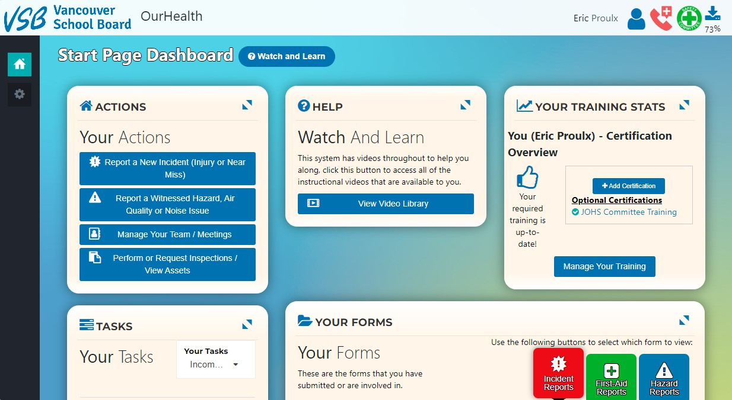
https://ourhealth.vsb.bc.ca/dashboard

Slide 17
Professional
Learning

Slide 18

What is Professional Development?
What is Professional Autonomy?
What is Professional Autonomy?
What does Pro-D look like in our district?

Slide 19
What Professional Development Opportunities Exist at the VSB?
(District) Temporary Supplemental Fund
(District) Collaborative Inquiry Fund
School-Based Pro-D Funds
VEAES Mentorship Grant
BC PSA Day

Slide 20
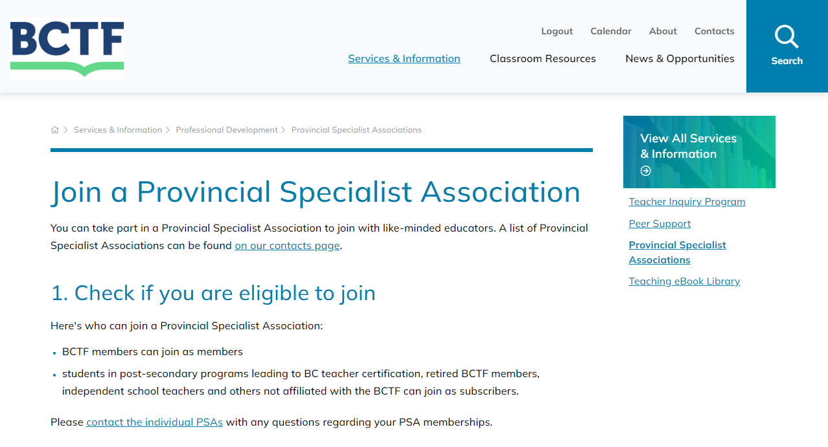
Provincial Specialist Associations
Notes:
https://www.bctf.ca/topics/services-information/professional-development/join-a-provincial-specialist-association

Slide 21
My BCTF
Union Services and
Involvement

Slide 22

BCTF website
bctf.ca

Slide 23
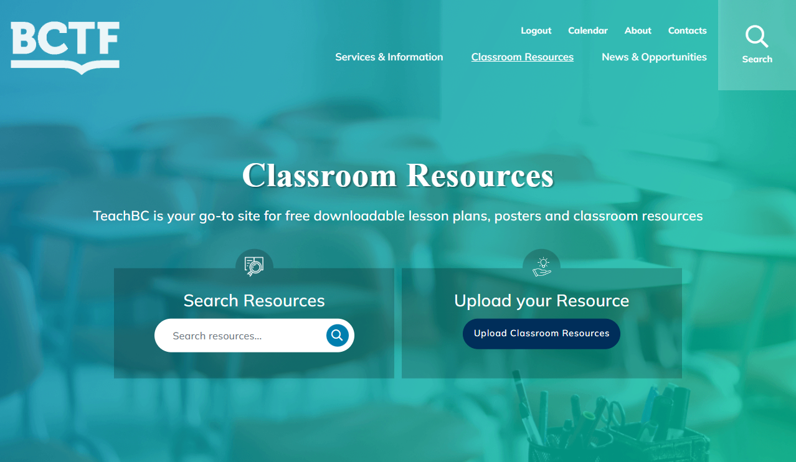
Teaching and Classroom Resources
bctf.ca/classroom-resources

Slide 24
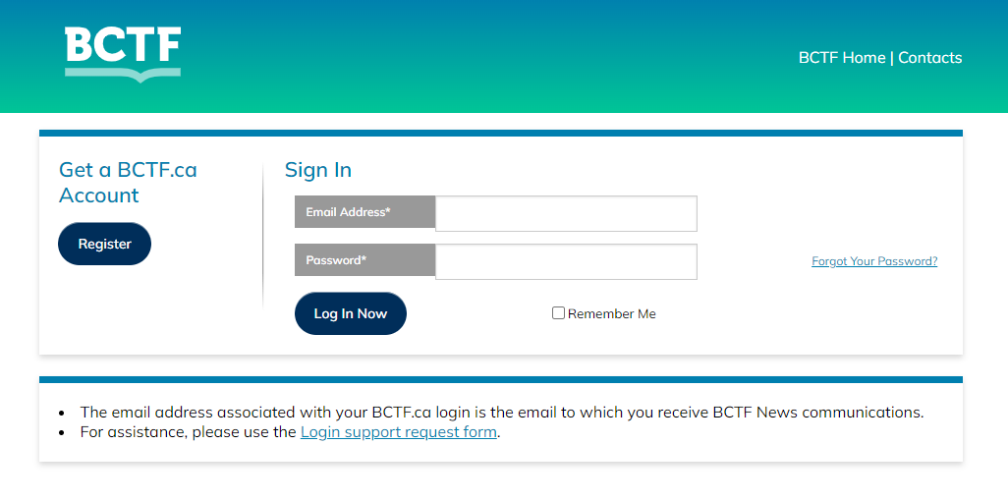
members.bctf.ca

Slide 25



Professional Challenges
Take a few minutes individually to fill in the “Challenges” column.
Then discuss the “Challenges” with others at your table and share the support mechanisms people have found helpful.
Use the post-it notes to write down what you could benefit from or what you need from your union and stick it on the wall or follow up with your local president to discuss.

Slide 26
Union Structures: Provincial, Local and Site
School Administration
VEAES/VSTA Staff Advisory Committees
VEAES/VSTA Site Rep
Professional Development Committee
Finance Committee
Parent Advisory Committee
Joint Occupational Health and Safety Committee
Diversity Equity and Inclusion Committee

Slide 27
Union Structures: Provincial, Local and Site
VSB
VTF
VSB Board: School Trustees
VEAES
VSTA
Superintendent
Executive Council, Local Rep Assembly, Standing Committees and Staff Committees
Executive Council, Local Rep Assembly, Standing Committees and Staff Committees
Elementary Schools
Secondary Schools

